Slide 1
JARVIS Voice Assistant
Kaniz Fatima-18201030
Mehedi Hasan-18201042

Slide 2
CONTENTS
Motivation.
Problem Statement.
Objective & Solution.
Impact on Society.
Critical Challenges & Risk Analysis.
Project output (Result).
How P’s, K’s & A’s are Addressed Through the Project.

Slide 3
Motivation
Our motivation of developing this software was to make an open-source voice recognition system which can be edited and developed more by any user according to their need without spending huge amount of money on traditional voice recognition systems.

Slide 4
Problem Statement
People want to use that voice assistant as per their individual needs. We solve that problem by implementing an open-source voice recognition system which is JARVIS.

Slide 5
Objective & Solution
Our objective is to develop a Voice recognition assistant which can be implemented easily and modified by any user. For building it we have used pure python and exploited its different modules to implement it.

Slide 6
Impact on Society
Reduces human effort
Less
consumed time
Almost like a human companion
More efficient
Usage without Account
More effective

Slide 7
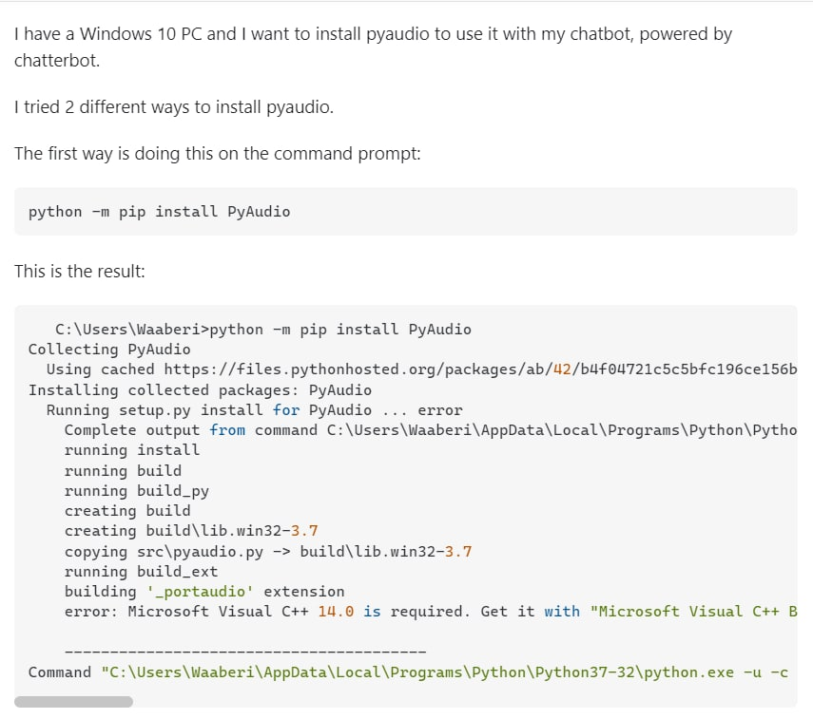
Risk Analysis(Critical Challenges)
The same problem occurred while installing pyaudio and as solution we had to get it using a third-party website and installed it using windows PowerShell. As third-party website we used unofficial python binaries.

Slide 8
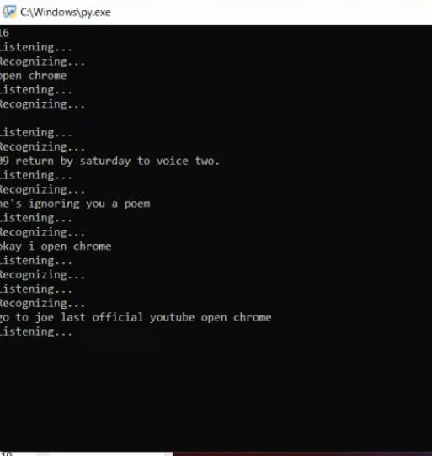
Risk Analysis(Critical Challenges)
Another problem we have faced is that the voice assistant sometimes misinterprets the commands the users give it. It is a very complex problem to fix since it doesn’t understand too fast or too complicated commands.

Slide 9
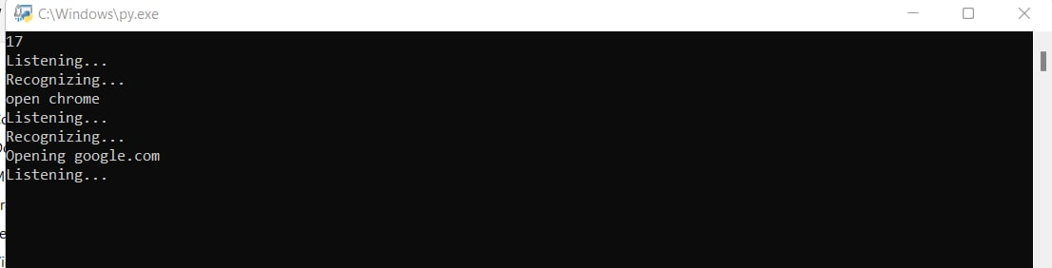
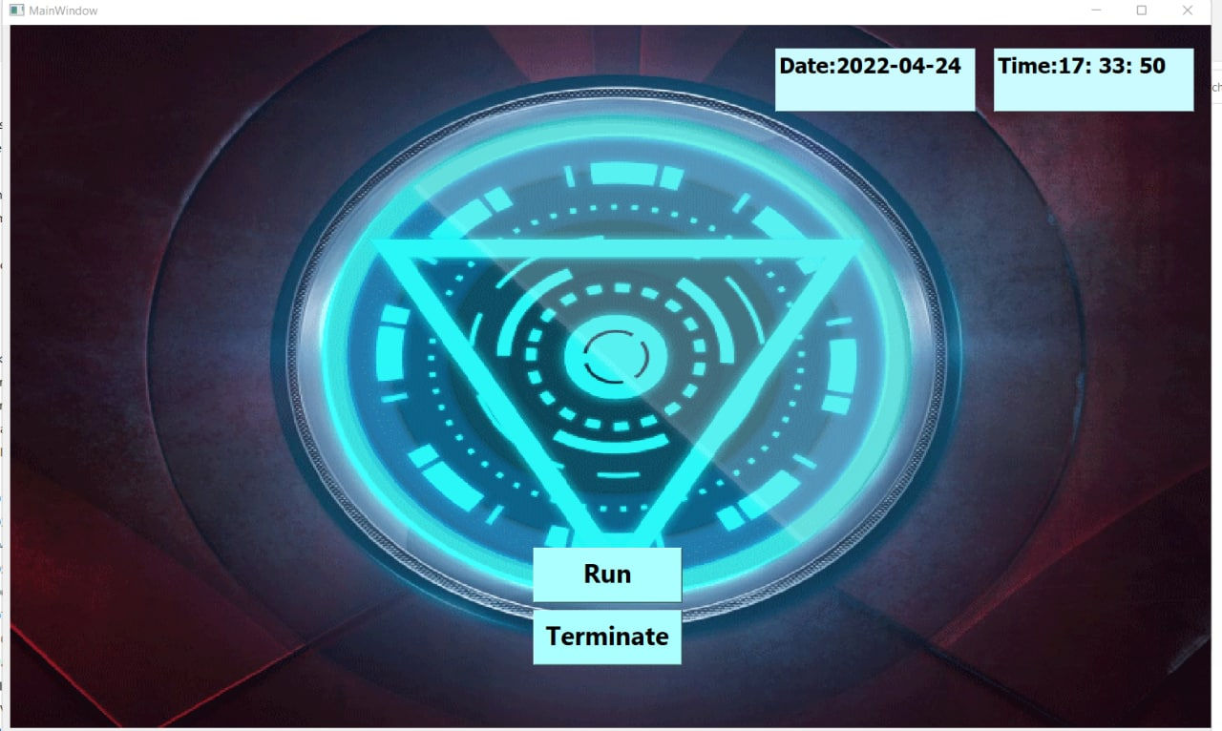
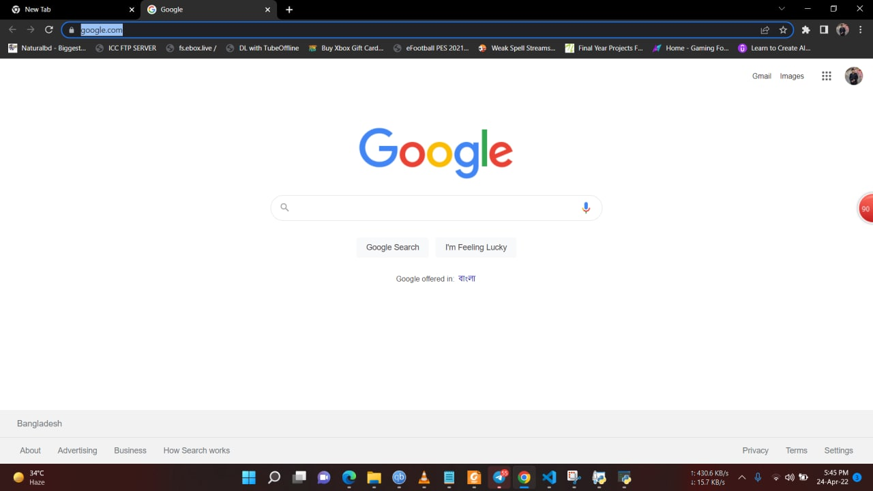
Project Output(Result)
This is how the Project looks like when it is booted up.
Input
Output

Slide 10
How the K’s are Addressed
Ks | Attributes | How the K’s addressed through the project | Cos | POs
K3 | Engineering Knowledge Fundamental | This project requires knowledge of Python and PyCharm IDE and a good understanding of concepts of AI. Data analysis is also required. | CO1 | PO-a
K4 | Specialist Knowledge | On this system, there will be a machine learning and Artificial Intelligent based frontend which will need advanced engineering knowledge to implement. | CO1, CO2, CO4 | PO-a, PO-b, PO-e
K5 | Engineering Design | Here, we are using modern engineering design to identify and solve the problem with a powerful and more efficient approach. | CO3, CO4 | PO-c, PO-e
K6 | Engineering Practice | As we will need to implement voice recognition system, so using advanced technology for that is necessary. | CO5 | PO-f
K8 | Research Literature | A project requires a study of existing systems with similar goals such as Google Assistant, Amazon Alexa, and Microsoft Cortana. | CO10 | PO-l

Slide 11
How the P’s are Addressed
PS | Attributes | How the P’s are addressed through the project | COs | POs
P1 | Depth of Knowledge requirement | The project requires rigorous study of all existing virtual voice assistant (K8), conducts surveys on stakeholders’ customers, sellers, and monitoring authority (K3, K4), web-based backend, and frontend design (K5, K6). | CO1, CO2 | PO-a, PO-b
P2 | Range of conflicting requirement | Conflicting requirement: User data security with user data sharing in website. | CO2 | PO-b
P3 | Depth of analysis requirement | No obvious formulation as a machine learning problem. Depth of analysis is required to select the best algorithm for maximizing the result. | CO4, CO6 | PO-e, PO-h
P4 | Familiarity issues | Lack of open-source AI Assistant and traditional existing AI Assistant being very costly. | CO5, CO8 | PO-f, PO-k
P7 | Interdependence | This project involves interdependent components such as requirement analysis, designing back-end, frontend, data collection, training module and detection etc. | CO7, CO8 | PO-i, PO-k

Slide 12
How the A’s are Addressed
As | Attributes | How the A’s are addressed | COs | POs
A1 | Range of Resources | For developing this project, we need diverse resources such as python, Visual Studio code IDE, python GUI. Also, we would need different python modules that can communicate and interact with user using voice command. Also, efficient developers are needed to implement it perfectly. | CO8 | PO-j
A2 | Level of Interaction | Users will give inputs using voice commands and the project will recognize what is being told using different Voice to text Modules and give output to the satisfaction of the user. | CO8 | PO-j
A5 | Familiarity | This project deals with Artificial Intelligence Based on NLP (Natural Language Processing). | CO8 | PO-j

Slide 13
THE END!
Thank You!

